Slide 1
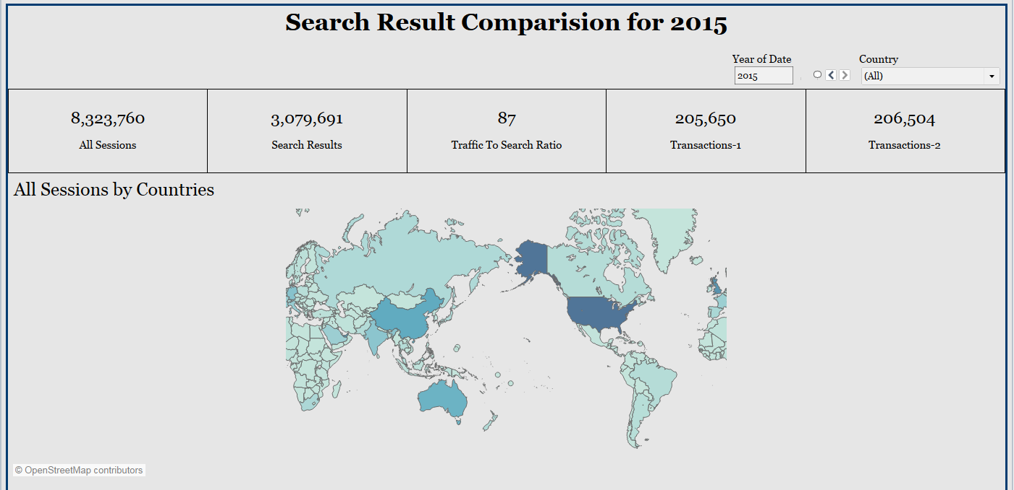
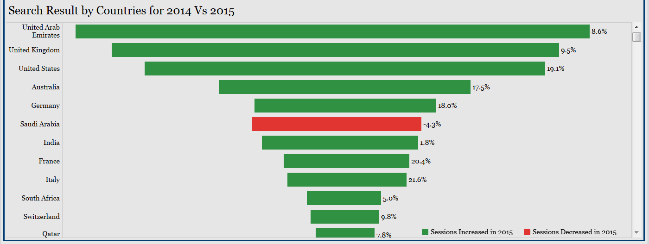
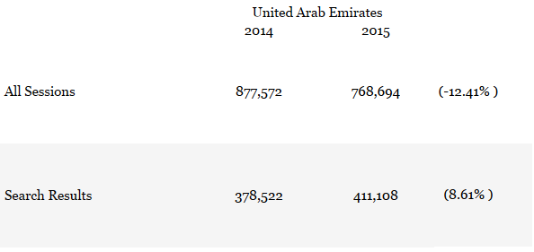
Task 1
(Analysis exclusive for UAE)
I would like to differ from the given hypothesis as the values given in attached spreadsheet are different.
Search results have increased significantly i.e. fro 3.7 Lakhs to 4.1 Lakhs (~8 %).
However, Traffic to the site has been reduced from 8.7 Lakhs to 7.6 Lakhs (~13 Reduction and not increment).

Slide 2
Task 2
The five elements that would act as KPI are:
Column k:Indicates flight booking type
Column O: promo codes being applied
Column Q: mode of reach/ information gained
Column R: directed from which site/ browing methods
Column T: Additional information regarding the purpose of site visit

Slide 3
Task 3
Normalization can be referred as transforming data which can be consumed by various statistics models.
In the task2 we have identified 5 key elements (Namely : column K,O, Q, R, T) for which we will do transformation and run various statistics model on the same.

